Slide 1
Autonomous Mobile Manipulator
Project Execution Plan and IP Landscape presentation
Tom Queen and Daniel Gregory-Turner
Abstract / intro

Slide 2
Research Question
Can a compliant robot arm be integrated into a self-navigating robot platform and programmed to autonomously to identify, locate, grasp and transport objects using data from cascaded camera systems with comparable reliability to existing systems as a function of development time and cost?

Slide 3
Research Objectives
Evaluate current methods of autonomous object fetching with respect to functionality and reliability as a function of cost
Explore methods of camera based object recognition and localisation from cascaded camera systems, and the interaction between these systems
Investigate and develop a novel approach to grasping a variety of objects
Build a system capable of autonomously navigating an environment, locating a desired object and transporting the object to a location with comparable reliability to existing systems as a function of development time and cost.

Slide 4
Project description and objectives
Some example requirements
(& success criteria)
E.g.
Requirements:
Object recognition
Object localisation
Navigate to object
Positioning gripper
Object grasping
Location storage
User interface

Slide 5
Hardware
Software

Slide 6
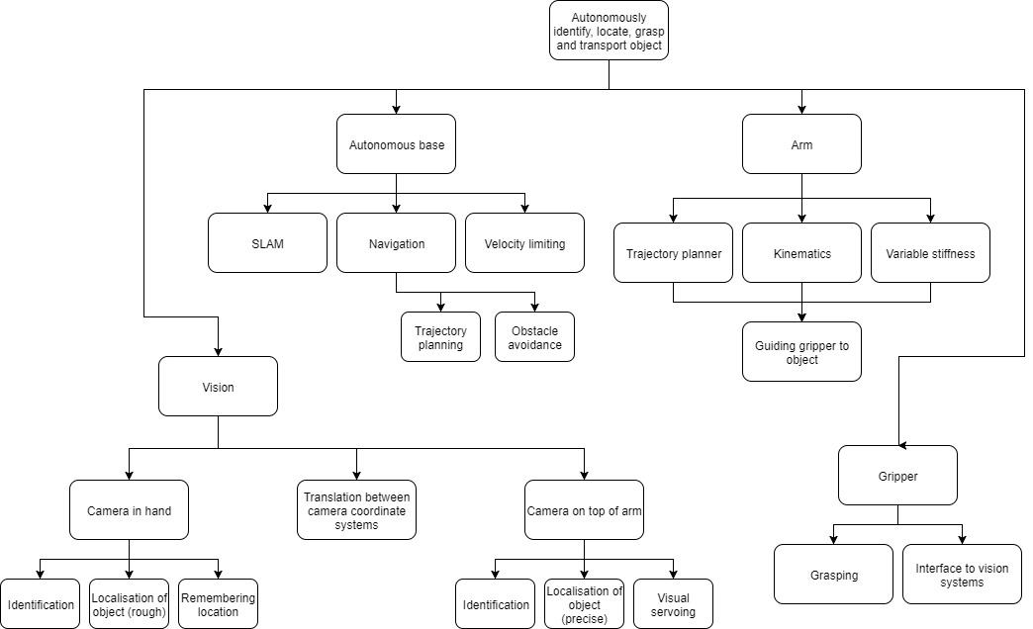
Systems Breakdown

Slide 7
PICTURE OF THE BASE

Slide 8
Design Process
Flowchart
Testing examples

Slide 9
Project Management
Philosophy:
Traditional project management theory
Adaptive path method
Roles
Responsibilities
 | Project manager | Electrical manager | Mechanical manager | Software manager | Systems architect | Financial manager
Tom | X | X |  |  | X
Daniel | X |  | X | X |  | X

Slide 10
Risk Management

Slide 11
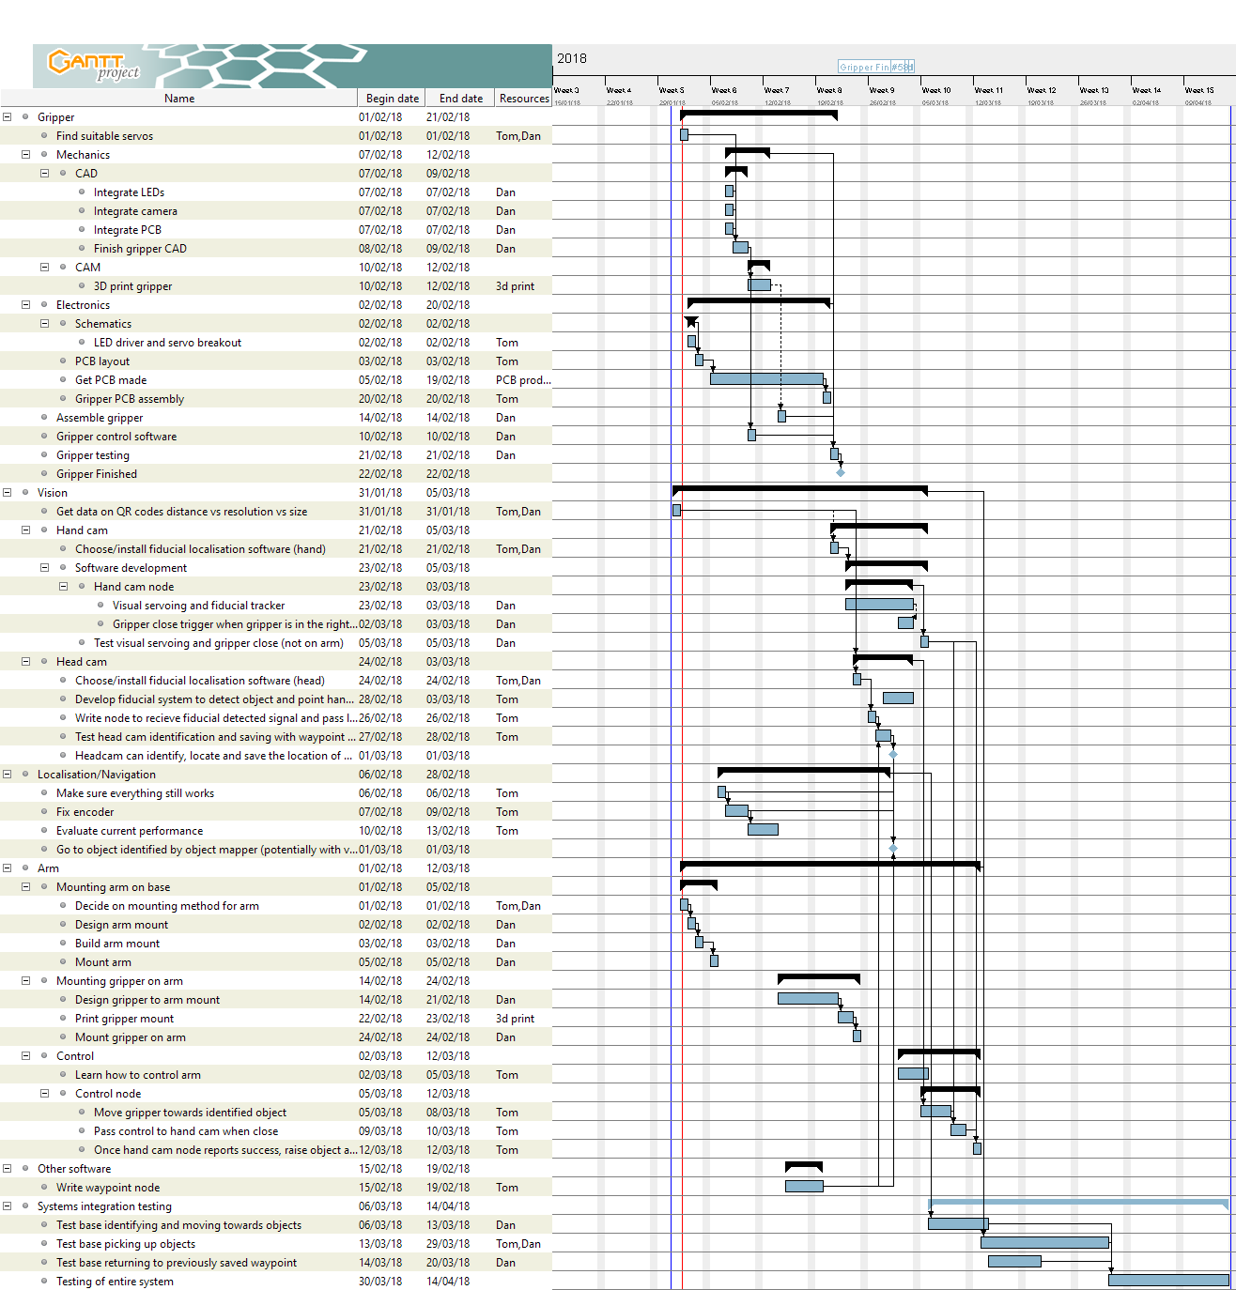
Time plan

Slide 12
IP Landscape
Generalness regarding robotic systems:
All SLAM robots
Aquire, process, visualise
General Gripper

